Slide 1
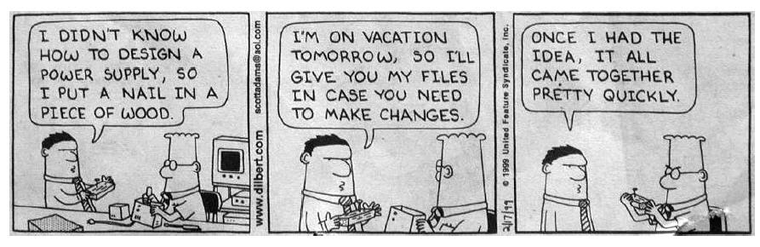
The Preliminary Design
You Don't Want To See!

Slide 2

User Interface Design
Easy to learn?
Easy to use?
Easy to understand?
Golden Rules
Place the user in control
Reduce the user’s memory load
Make the interface consistent
Notes:
System users often judge a system by its interface
A poorly designed interface can cause a user to make catastrophic errors
Poor user interface design is the reason why so many software systems are never used
Focus in this chapter is on graphical user interface design.
Two problems must be addressed in interactive systems design
How should information from the user be provided to the computer system?
How should information from the computer system be presented to the user?

Slide 3
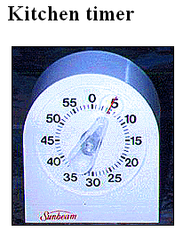

Slide 4

Interface Design
Typical Design Errors
lack of consistency
too much memorization
no guidance / help
no context sensitivity
poor response
Arcane/unfriendly
Notes:
Didn’t understand the needs of the users
Didn’t understand the knowledge level and/or experience level of the users
For example, an office system should use concepts such as
letters, documents, folders etc. rather than directories, file
identifiers, etc. Do the same in the user’s manual.

Slide 5
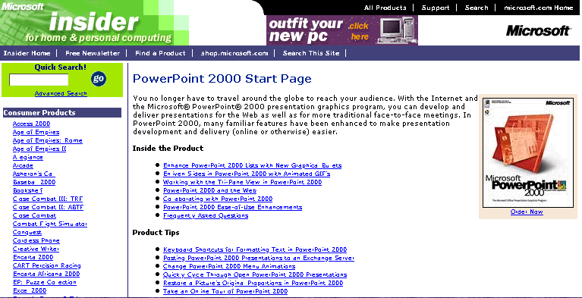
Fonts Too Small

Slide 6
Place the User in Control
Define interaction modes in a way that does not force a user into unnecessary or undesired actions.
Provide for flexible interaction.
Allow user interaction to be interruptible and undoable.
Streamline interaction as skill levels advance and allow the interaction to be customized.
Hide technical internals from the casual user.
Design for direct interaction with objects that appear on the screen.
Notes:
The system should not surprise the user
If a command operates in a known way, the user should be
able to predict the operation of comparable commands.
The system should provide some resilience to
user errors and allow the user to recover from errors
This might include an undo facilities, confirmation of
destructive actions, 'soft' deletes, etc.
Some user guidance should be supplied
Help systems, on-line manuals, etc.

Slide 7
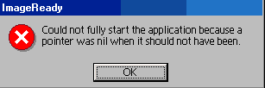

Slide 8
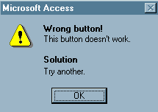

Slide 9
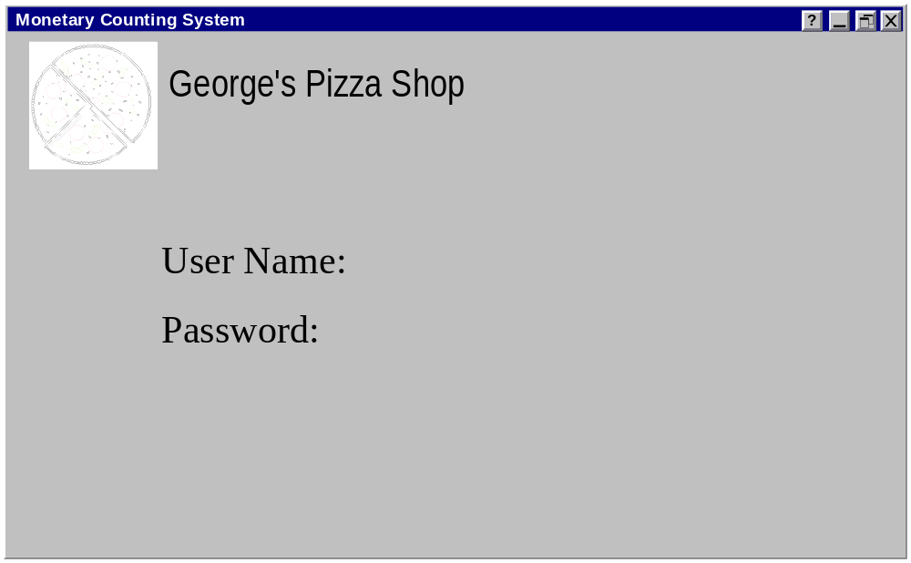
The Login GUI

Slide 10
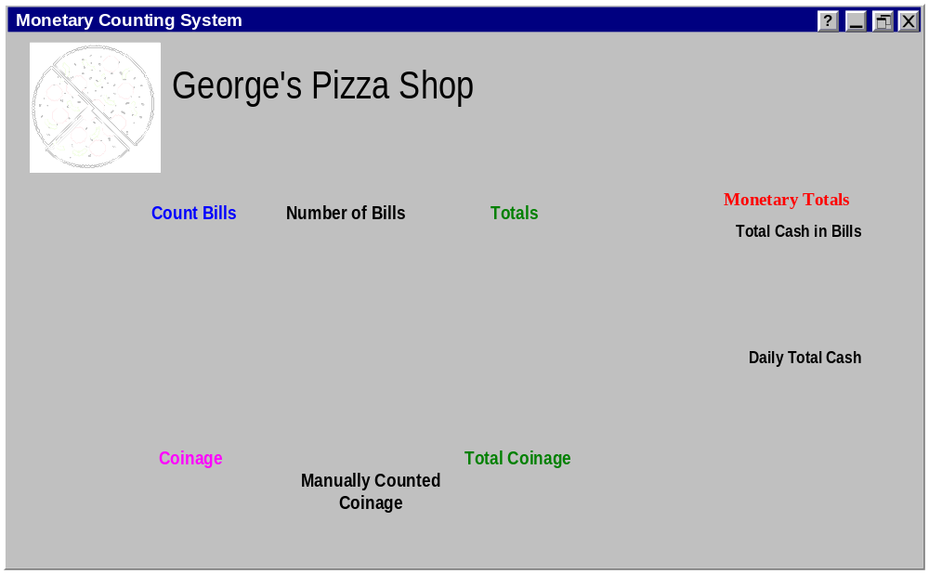
Results of Cashier’s Successful Login

Slide 11
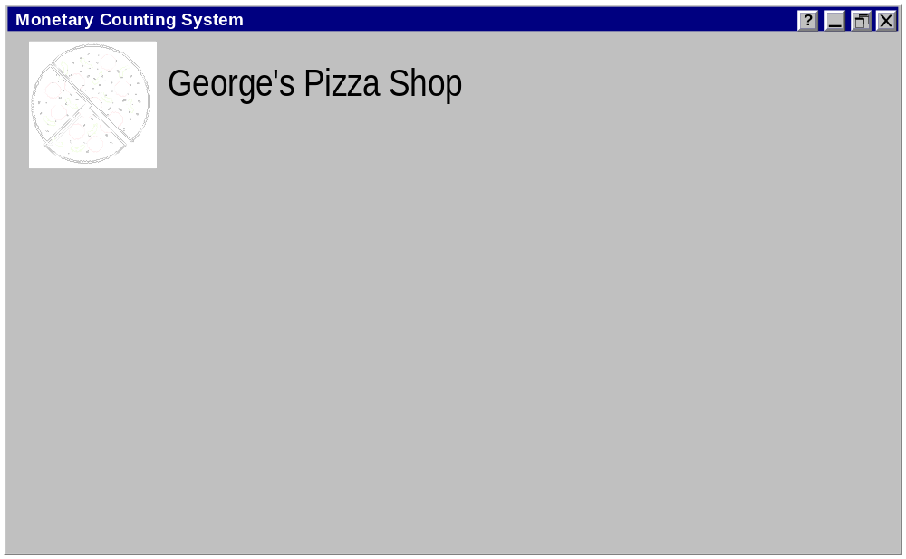
Results of Administrator's
Successful Login

Slide 12
Reduce the User’s Memory Load
Reduce demand on short-term memory.
Establish meaningful defaults.
Define shortcuts that are intuitive.
The visual layout of the interface should be based on a real world metaphor.
Disclose information in a progressive fashion.

Slide 13
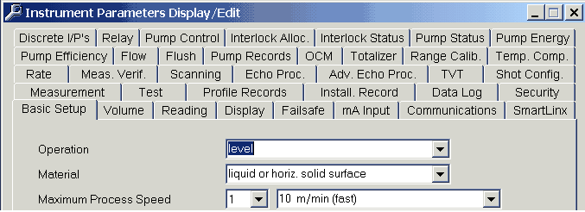
To Tab or not to Tab, that is the Question!

Slide 14
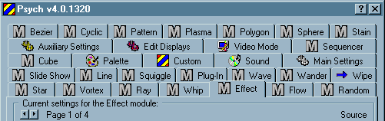

Slide 15
Make the Interface Consistent
Allow the user to put the current task into a meaningful context.
Maintain consistency across a family of applications.
If past interactive models have created user expectations, do not make changes unless there is a compelling reason to do so.
Notes:
Commands and menus should have the same format,
command punctuation should be similar, etc.
If a command operates in a known way, the user should be
able to predict the operation of comparable commands.

Slide 16
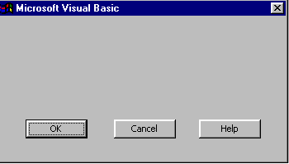

Slide 17
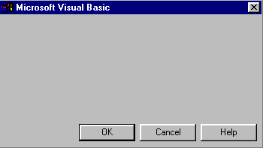

Slide 18
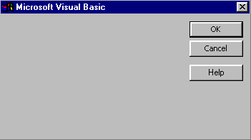

Slide 19
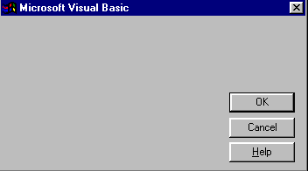

Slide 20
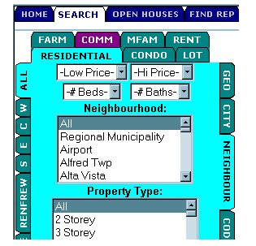
Ottawa-Carleton Real Estate Board

Slide 21
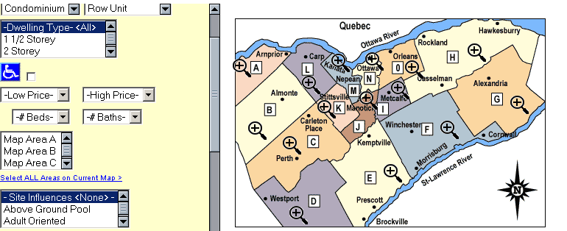
Ottawa-Carleton Real Estate Board

Slide 22
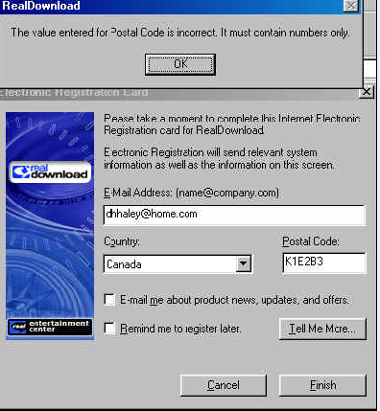

Slide 23
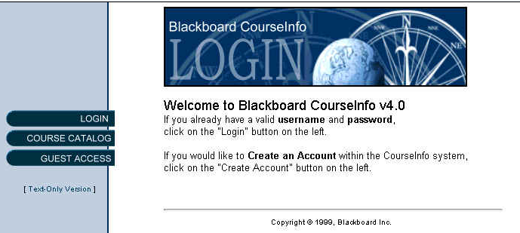

Slide 24
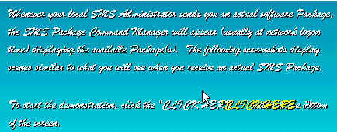


Slide 25
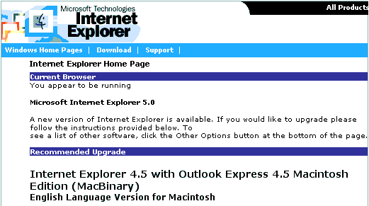

Slide 26
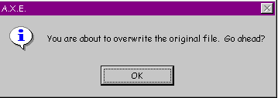

Slide 27
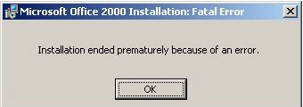

Slide 28
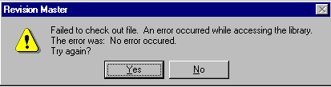

Slide 29
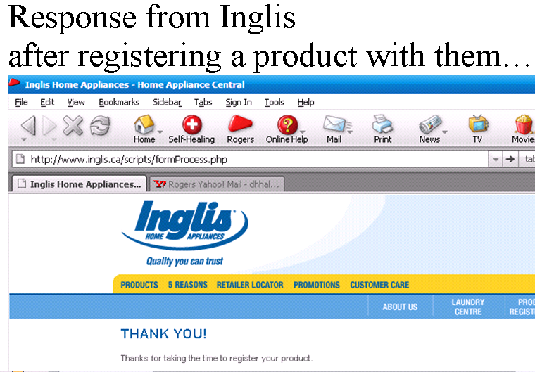

Slide 30
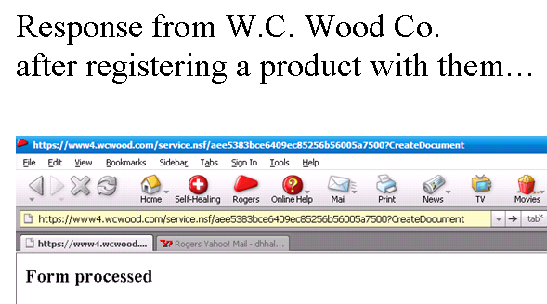

Slide 31
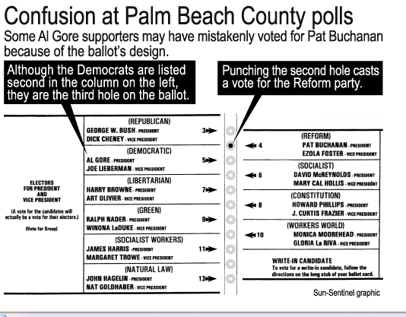
The 2000 USA Presidential Ballot in Florida

Slide 32
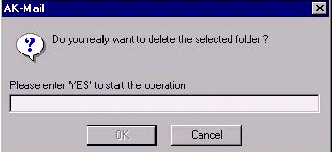
The User Isn't Stupid
Don't try to protect your users from themselves.
Some apps assume that the user is a security risk and that data should be protected by requiring the user to type in a message, usually a variant of "Yes", to proceed with the command the user has initiated.
Requiring keyboard input can also be inconsiderate towards users who have certain disabilities due to which they may not be good with the keyboard but can use the mouse.

Slide 33
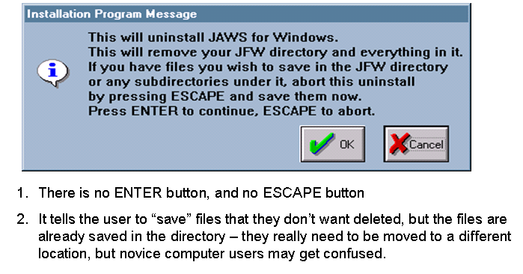

Usability Problems

Slide 34
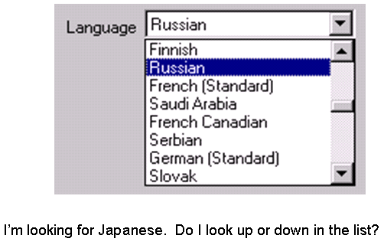
Usability Problems

Slide 35
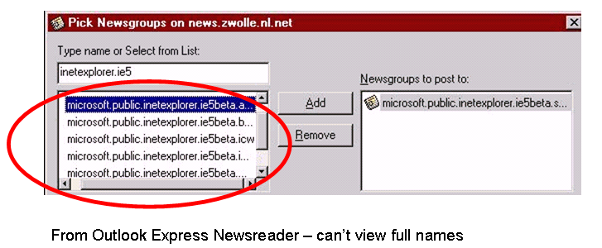
Usability Problems

Slide 36
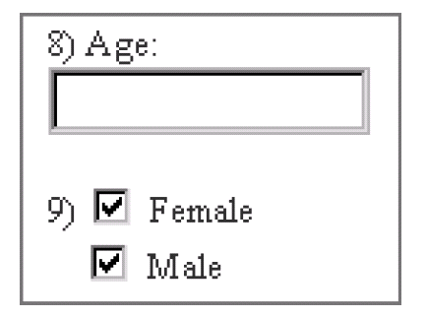
I'll Let You Decide!

